Slide 1

POORNIMA COLLEGE OF ENGINEERING
DEPARTMENT OF INFORMATION TECHNOLOGY
“Full Stack of Web Development”
Session: 2025-26
Presented to:
Ms. Priya Shekhawat
Ms. Shivani Jain
(Faculty Coordinators)
Presented By:
Student Name: Nirmal Todwal
Reg. No.:PCE23IT035

Slide 2
Technologies Used
HTML (Hyper Text Markup Language)
CSS (Cascading Style Sheets)
JavaScript (JS)
React.js
Node.js
Firebase

Slide 3
Project Description
NIDHI-SETU is an AI-driven, secure, and automated digital platform designed to ensure transparency, accountability, and dignity in the disbursement of government welfare and pension funds. The project addresses a critical national issue—billions of rupees lost annually due to payments made to deceased or fraudulent beneficiaries—by building a trustworthy bridge between citizens and government fund systems.
The project is built using a modern MERN-based architecture with React.js and Tailwind CSS for the frontend, Node.js and Express.js for the backend, and Firebase for authentication and database management. Additional AI and verification modules like Supabase, Twilio, and Retail AI enhance the platform’s accuracy and reliability. Robust AES encryption, image hashing, and cloud deployment ensure data integrity, privacy, and scalability.

Slide 4
Project Scope
The scope of the NIDHI-SETU project defines the objectives, boundaries, and technological framework for developing a secure, automated, and citizen-centric platform that ensures the rightful and transparent disbursement of government welfare funds. This system focuses on eliminating fraudulent or deceased beneficiaries, enabling real-time verification, and strengthening trust between citizens and government institutions.
User Features:
  Secure Login & Authentication: Beneficiaries and administrators access the platform through Firebase authentication (email, OTP, or Aadhaar-based).
  3D Face Verification: Real-time liveness detection using Supabase ensures that only live individuals are verified.
  Voice Verification Bot: Automated Twilio AI calls confirm user identity through voice responses.
  Fraud Detection: AI algorithms analyze trends and flag duplicate or suspicious entries.
Admin Features:
  Centralized Dashboard: Enables monitoring of all verification activities and data integrity logs.
  Backend: Powered by Node.js and Express.js, managing API routing, business logic, and integrations.
  Database & Authentication: Firebase handles user authentication, real-time data updates, and access control.
  Technical Scope:
  Full stack implementation using HTML, CSS, JavaScript, React.js, Node.js, and Firebase.
  Database management for cars, users, and bookings.
  Deployment on cloud-based hosting platforms for accessibility.

Slide 5
Learning
Technical Skills
In-depth understanding of HTML, CSS, and JavaScript for building responsive web interfaces.
Hands-on experience with React.js to create dynamic, component-based single-page applications.
Database operations and data management using Firebase for real-time updates and secure storage.
Version control and collaborative coding using Git and GitHub.
Deployment of full stack applications to cloud-based platforms.
Soft Skills
Problem-solving, debugging, and optimizing performance.
Teamwork, communication, and documentation for professional project delivery.
Time management and working with structured timelines (45-day schedule).

Slide 6
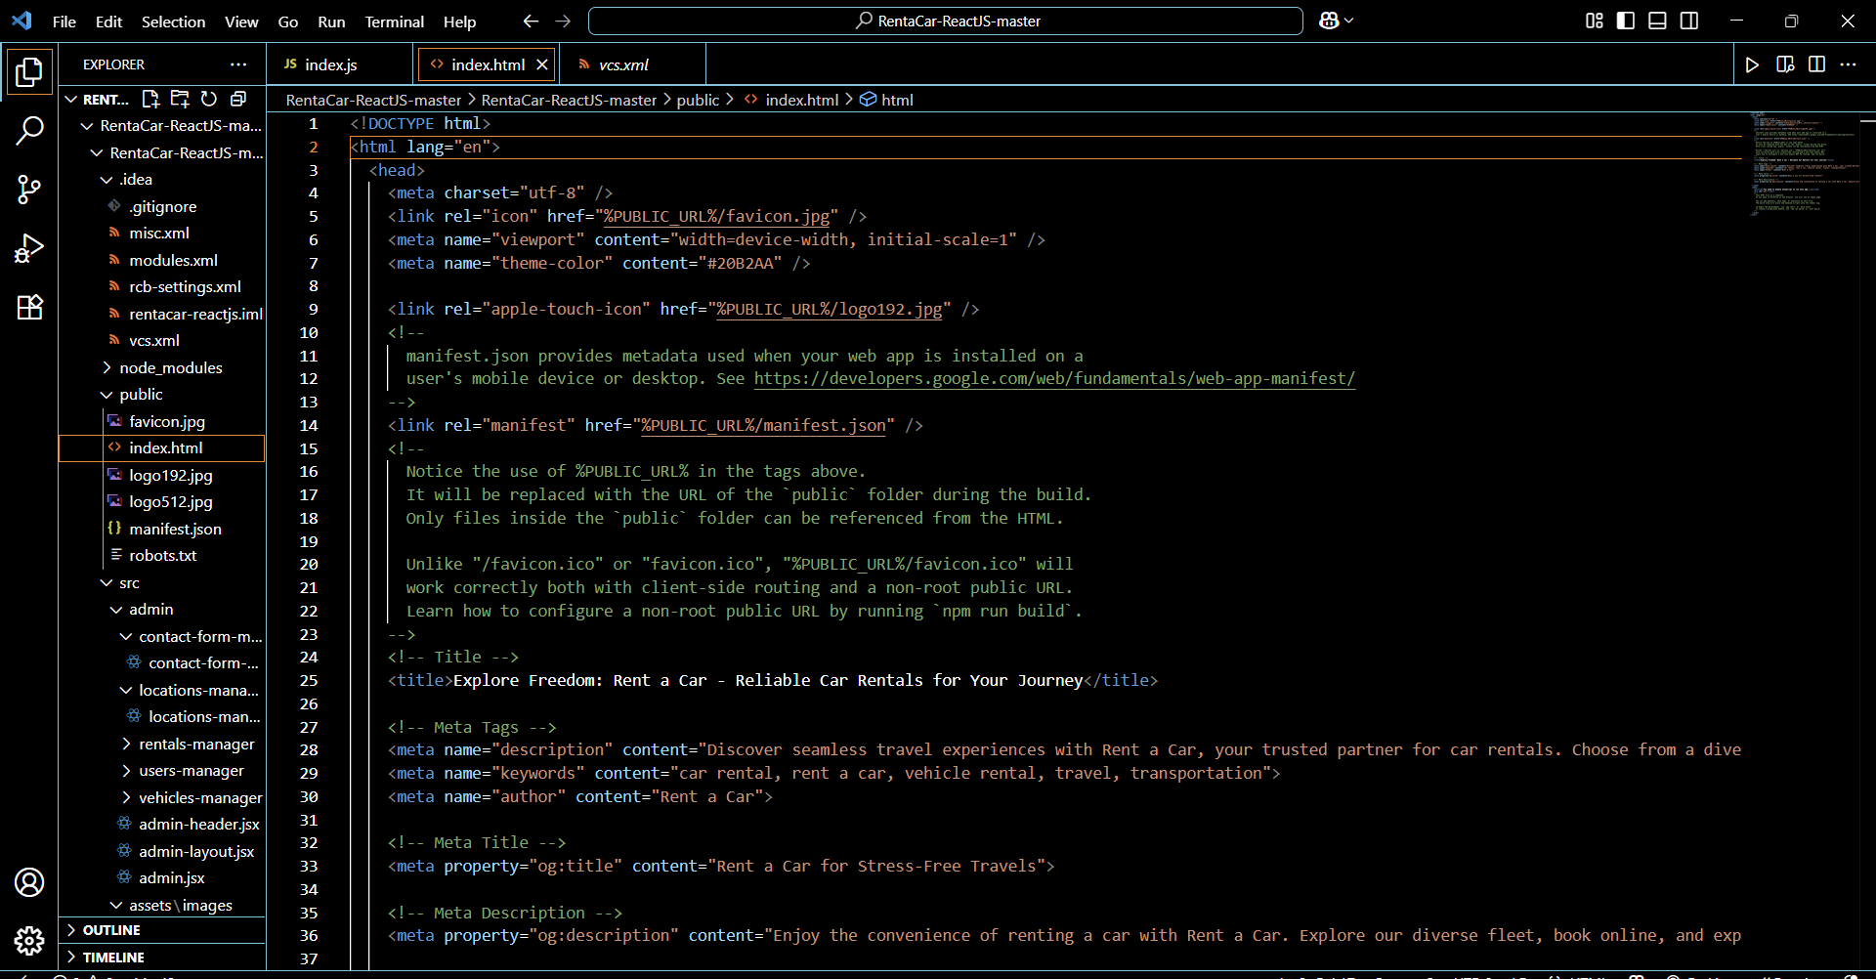
Snapshot of Project

Slide 7
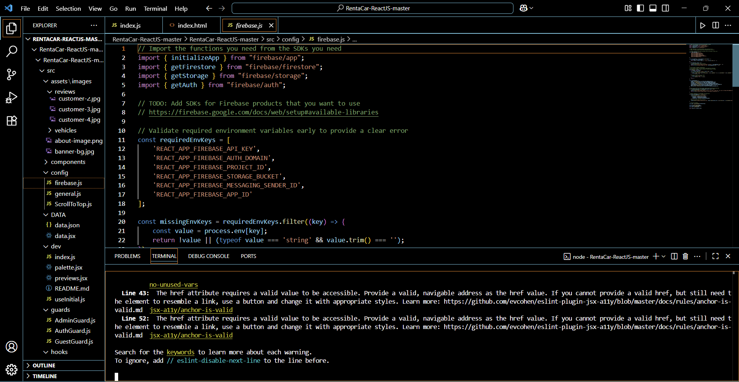

Slide 8


Slide 9
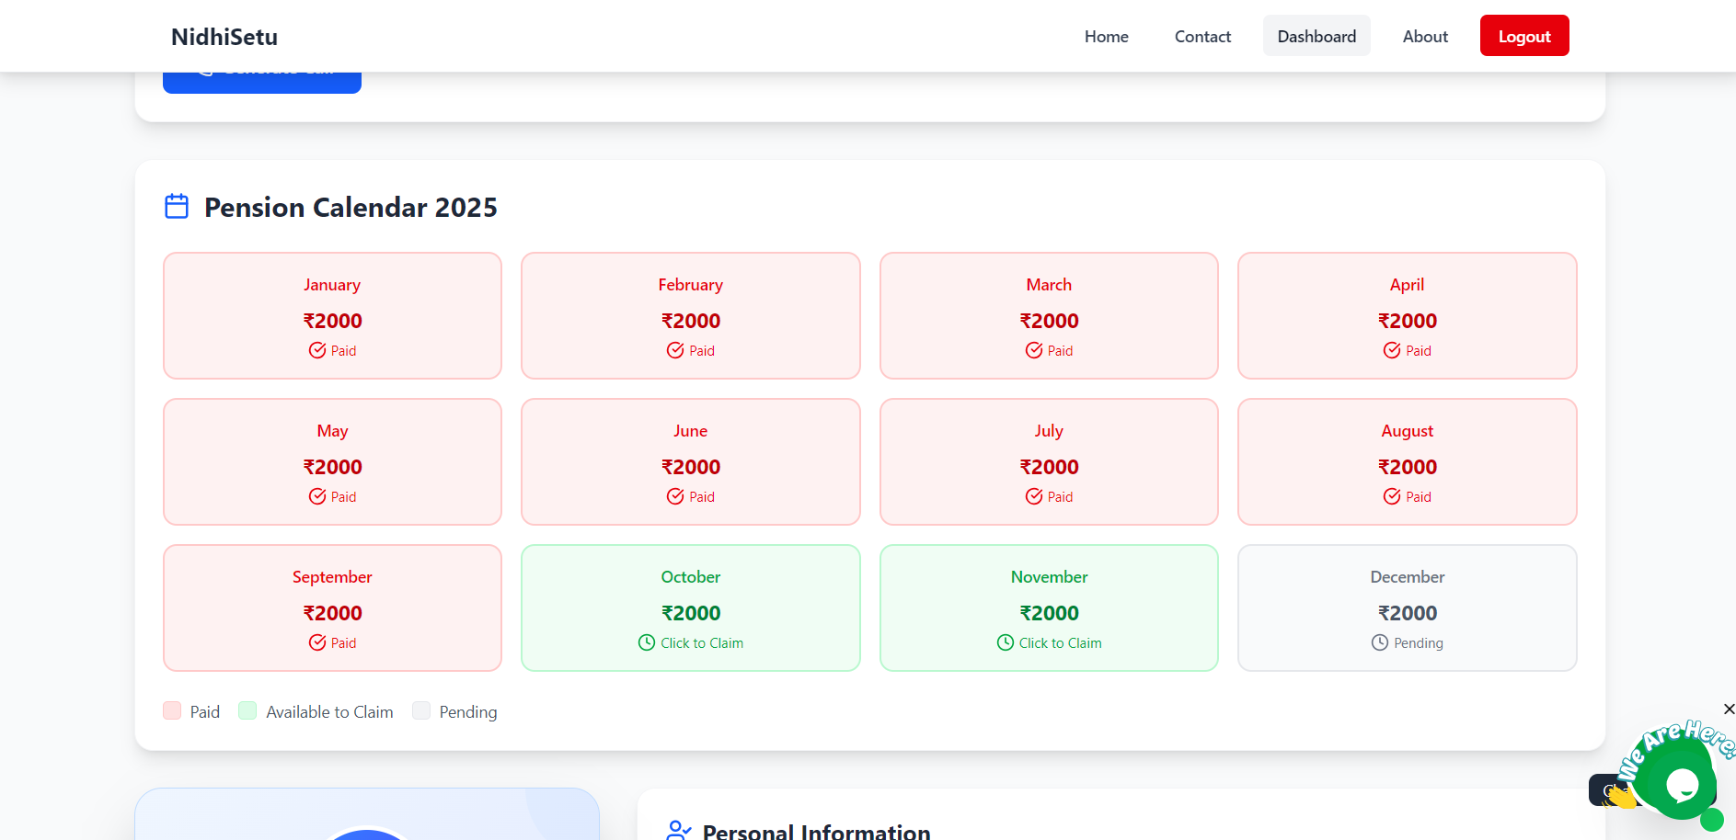

Slide 10
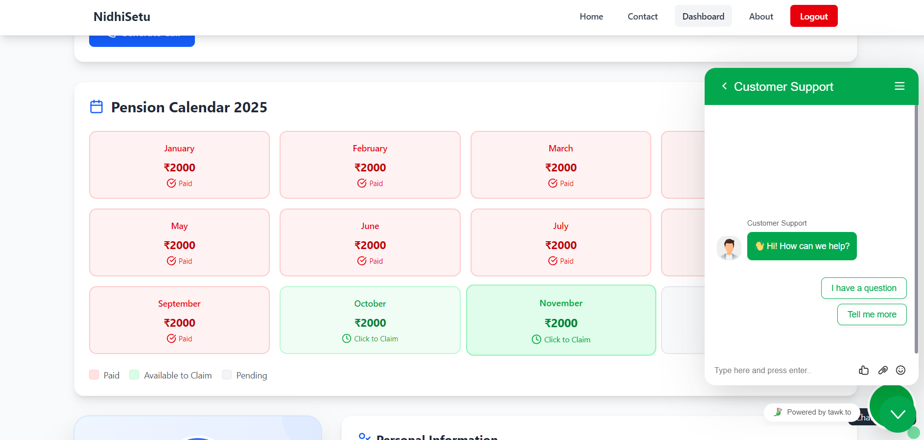

Slide 11
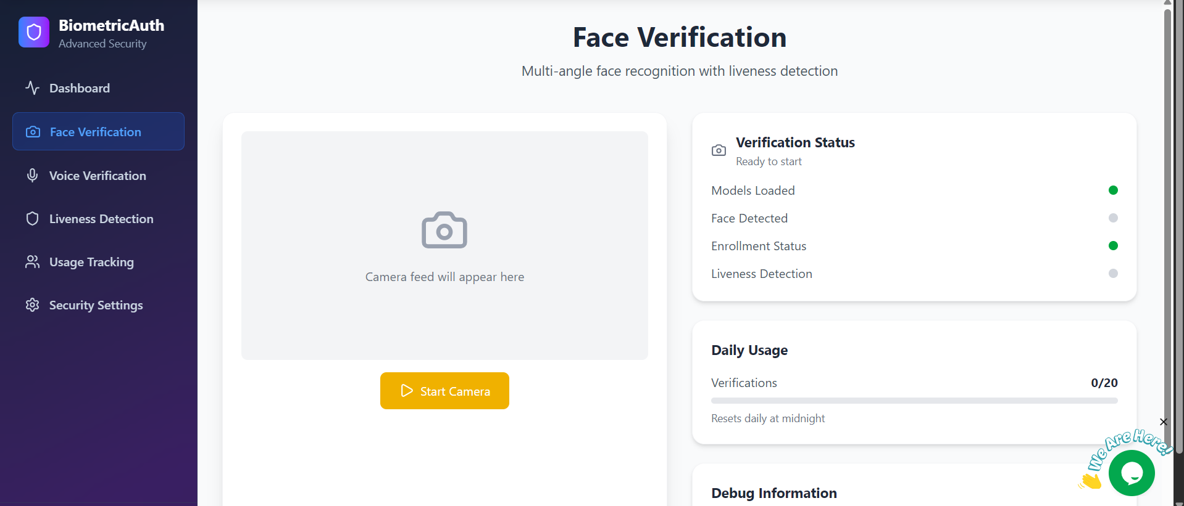

Slide 12
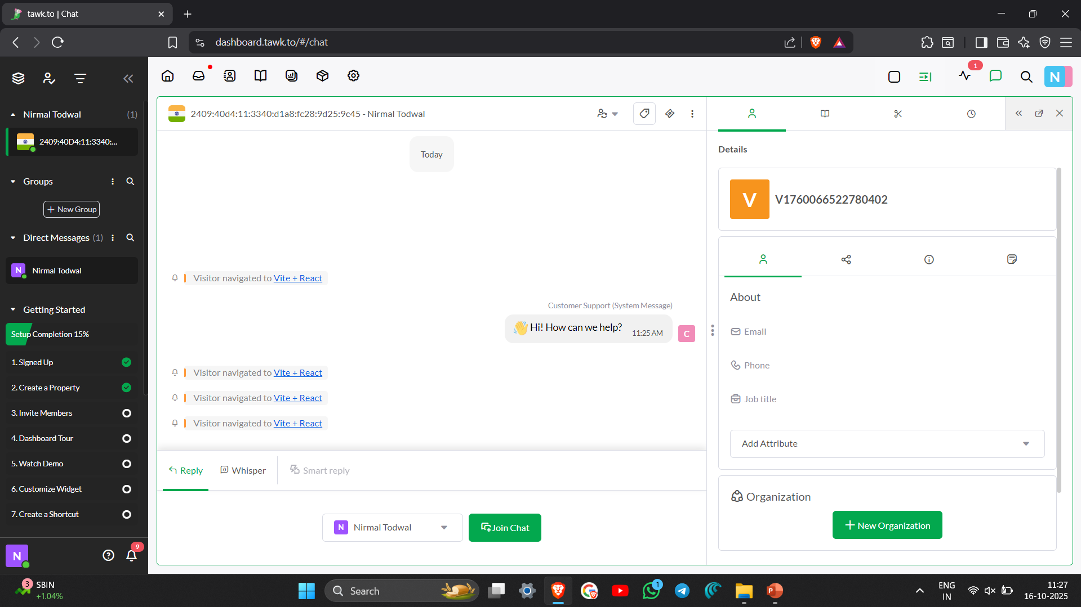

Slide 13
Future Scope
Scalability: Expand the platform to handle millions of beneficiaries and administrators across multiple states and welfare departments.
Mobile Integration: Develop dedicated Android and iOS applications using React Native for easier access and real-time verification on smartphones.
AI & Predictive Analytics: Implement advanced machine learning models to predict potential fraud patterns, detect anomalies, and improve beneficiary verification accuracy.
Blockchain Integration: Use blockchain technology to ensure transparent, tamper-proof, and traceable fund disbursement records.
Multilingual & Voice Assistance: Add regional language support and AI-based voice guidance to improve accessibility for rural and elderly users.
Offline Verification Mode: Introduce low-bandwidth or SMS-based verification for areas with limited internet connectivity.

Slide 14
Conclusion
The NIDHI-SETU project successfully demonstrates the application of Full Stack Web Development and AI-driven verification technologies learned during the training and implementation phase. By integrating React.js, Node.js, Express.js, Firebase, Supabase, Twilio, and Retail AI, the project delivers a secure, intelligent, and citizen-centric platform that ensures transparency and authenticity in government welfare fund distribution.
This practical implementation not only enhanced technical proficiency in frontend, backend, and database management but also provided valuable experience in developing scalable, real-time, and data-secure solutions aligned with national e-Governance goals. The system effectively utilizes 3D face and voice verification, AI-based fraud detection, and real-time data synchronization to eliminate duplication, misuse, and manual errors in beneficiary verification.
Through this project, hands-on expertise was gained in building a platform that bridges the gap between citizens and government agencies, ensuring that welfare benefits reach only the rightful recipients. It also strengthened knowledge in cloud deployment, authentication systems, and API integration.
Overall, the NIDHI-SETU project serves as a milestone in leveraging technology for social good—combining innovation, automation, and security to promote a transparent, efficient, and trustworthy digital welfare ecosystem, paving the way for future scalability and nationwide implementation.

Slide 15
References
Firebase Documentation – Authentication, Realtime Database, and Hosting.
https://firebase.google.com/docs
React.js Official Documentation – Frontend framework for building dynamic user interfaces. https://react.dev
Node.js & Express.js Documentation – Backend technologies for API routing and server-side development. https://nodejs.org/en/docs
Supabase Documentation – Used for real-time 3D face verification and secure data handling. https://supabase.com/docs
Twilio API Documentation – Voice and call automation for beneficiary verification.
https://www.twilio.com/docs
Tailwind CSS Documentation – Utility-first CSS framework for responsive and modern UI design.
https://tailwindcss.com/docs

Slide 16


